Slide 1

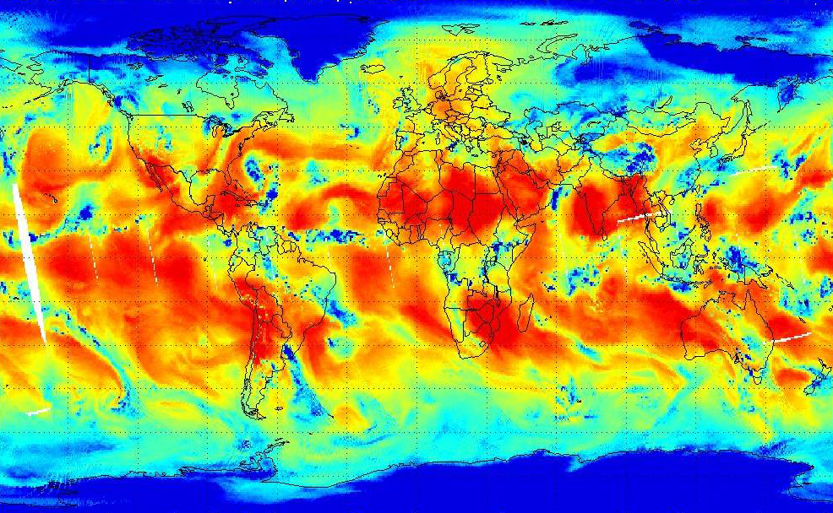

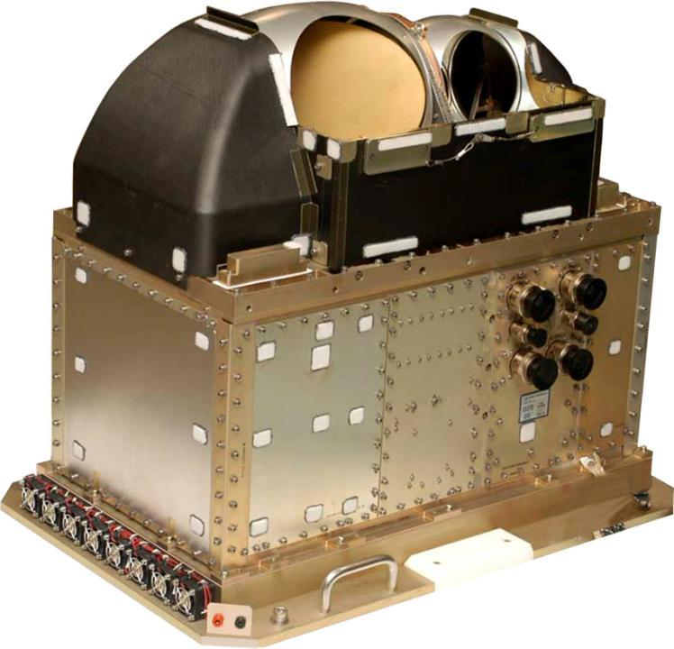
NPP ATMS Instrument
Performance
Kent Anderson
Chief Engineer,
Civil Space Programs
NG Electronic Systems
Azusa, CA
SDR Product Review, 23 Oct. 2012

Slide 2
Performance Investigations by NGES
Updated predicts of radiometric accuracy
Scan-dependent bias – causes and effects
Striping observed in radiometric counts

Slide 3
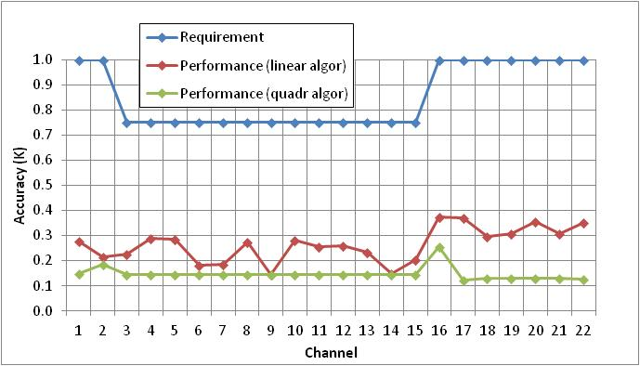
Radiometric Accuracy Performance
Performance predicts based on analytic model and data from :
  Non-linearity from ground calibration tests – Primary side only
  On-orbit data for updated temperatures and stabilities
Results computed for either linear algorithm (includes non-linearity errors), or for case of using the quadratic correction

Slide 4
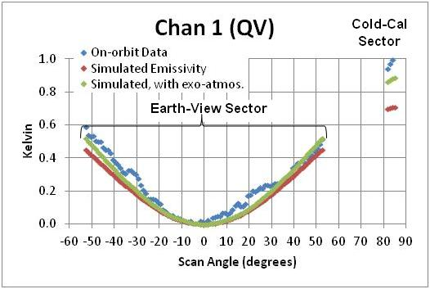
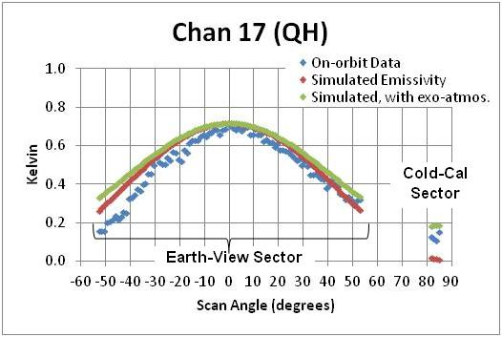
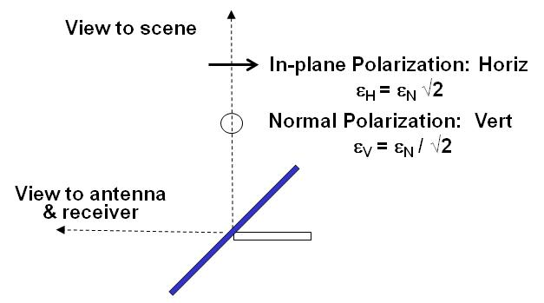
Developed Physical Model for Scan-dependent Radiometric Bias
ATMS pitch-maneuver data provided clear representation of the phenomenon, indicating errors on the order of 0.5 K if uncorrected
Physical cause has been identified – scan reflector microwave emissivity
Parameters for Simulation:
  Emissivity = 0.37%
  Temperature = 0.0° C
Emissivity contribution:
0.59 μ Gold over Ni / Be
Scanning Reflector Geometry

Slide 5
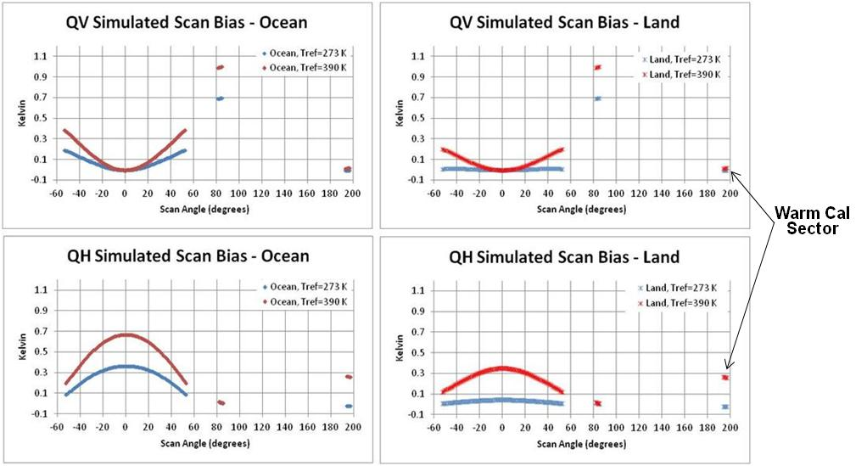
Requirements for Correction Algorithm
Determined that correction algorithm should include following:
  Emissivity contribution proportional to reflector temperature, which can vary over a range of 273K to 390 K
  Scene-dependent term to account for reflectivity variation with scan angle

Slide 6
Accuracy Performance – Including Scan-Dependent Bias Degradation
Based on predicted worst case error contribution of ± 0.5 K
  Assumes uniform distribution
  Standard deviation (1.0/√12) is RSSed with other random errors

Slide 7
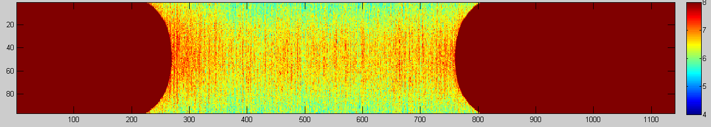
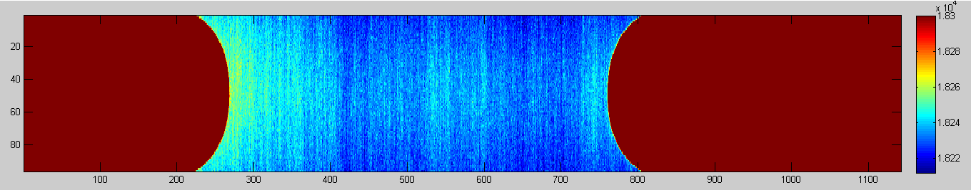
Striping Observed in Pitch Maneuver (Chan 18)
Kelvin
Counts x 10^4
Potential Contributors to Striping in Raw Counts Data:
  Low frequency (1/f) gain fluctuations
  Temperature – induced gain fluctuations

Slide 8
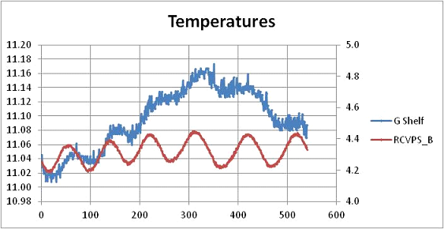
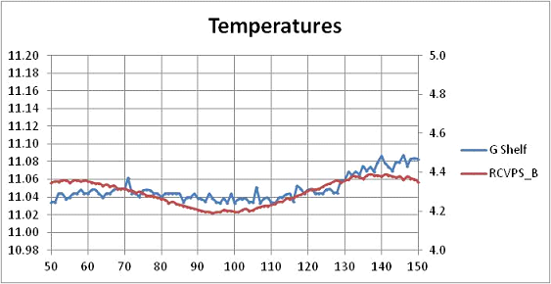
Temperature Fluctuations
RCVPS_B is indicator of SC control fluctuations, at instrument baseplate: 0.2° C peak-to-peak
Considerably attenuated at receiver G shelf: 0.02° C pk-to-pk
Variations from scan to scan are the expected telemetry noise – not actual temperature fluctuations
Concluded that striping is not due to temperature fluctuations

Slide 9
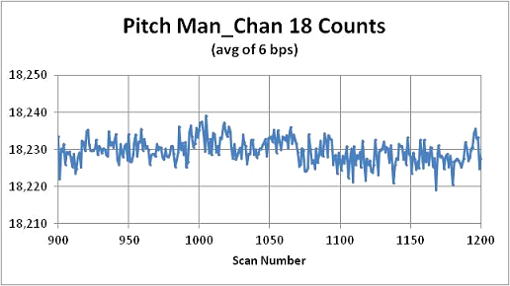
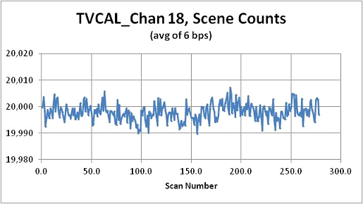
Comparison to TV Cal Data
For each scan, plotted average counts over 6 beam positions
Fluctuations essentially same as for TV Cal
Peak-to-peak:
  18 counts
  1.2 K
Standard deviations:
  3.3 counts
  0.22 K
On-orbit striping noise is at same level as 1/f noise measured during ground calibration

Slide 10


